Slide 1

Neural Networks
By Paul Abhishek

Slide 2

Table
of
Contents
Introduction to Neural Network
Introducing the data set
Data Cleaning
EDA
Feature Selection and Encoding.
Experimentation
conclusion

Slide 3
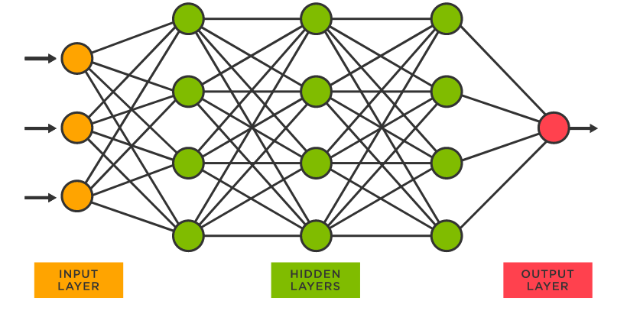
What is a neural network ?
A neural network is a method in artificial intelligence that teaches computers to process data in a way that is inspired by the human brain. It is a type of machine learning process, called deep learning, that uses interconnected nodes or neurons in a layered structure that resembles the human brain.
Importance :
Neural networks can help computers make intelligent decisions with limited human assistance. This is because they can learn and model the relationships between input and output data that are nonlinear and complex.

Slide 4
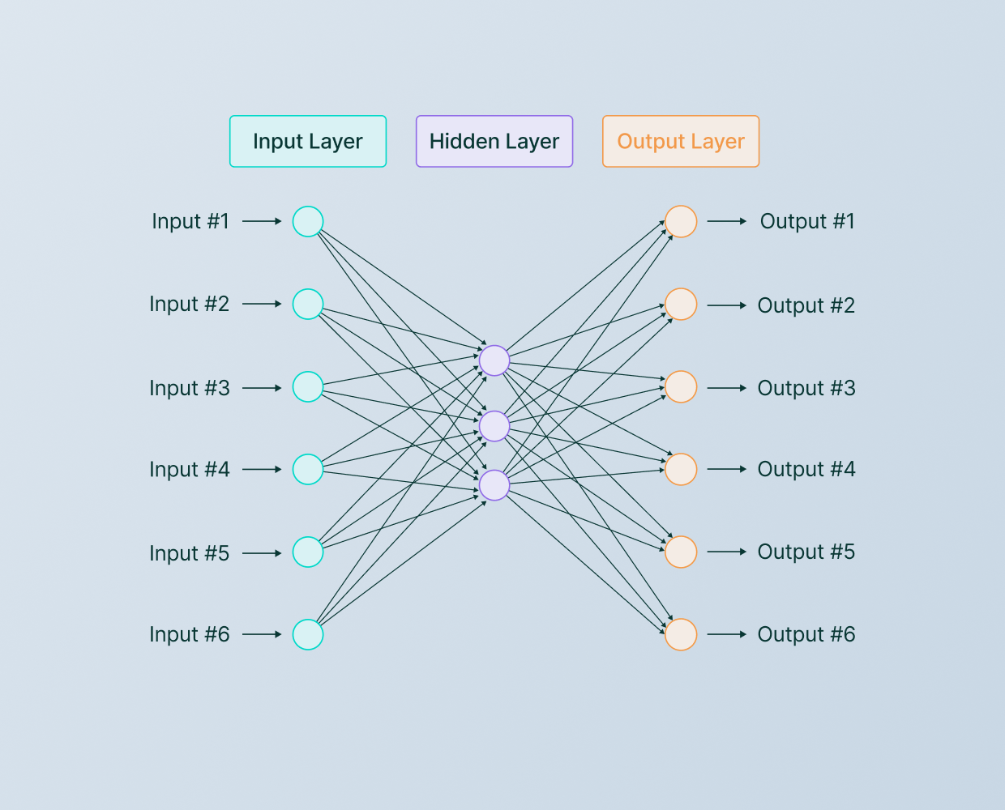
Architecture
The architecture provides the working parameters—such as the number, size, and type of layers in a neural network. Models are one piece of your architecture; a specific instance that trains on a chosen set of data. For example, in a neural net, the trained weights of each node, per the architecture, comprise the model.
There exist five basic types of neuron connection architecture :
Single-layer feed-forward network.
Multilayer feed-forward network.
Single node with its own feedback.
Single-layer recurrent network.
Multilayer recurrent network.

Slide 5
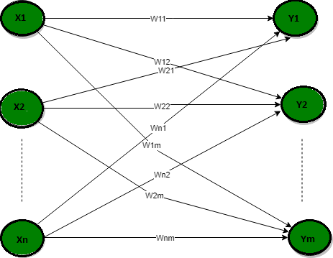
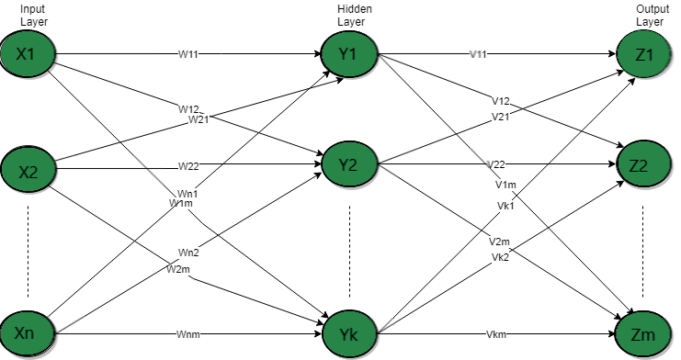
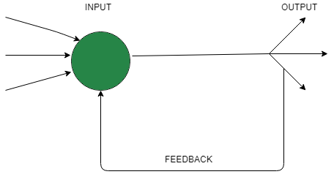
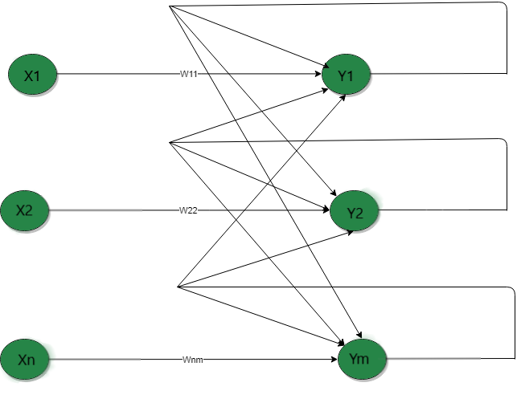
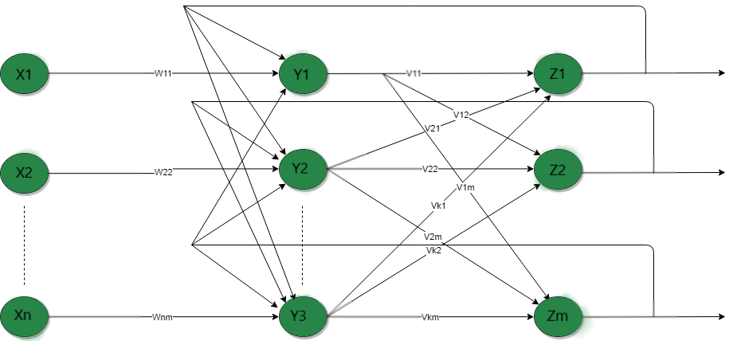
Single-layer feed-forward network
Multi Layer feedforward network
Single node with its own feedback
Single-layer recurrent network.
Multi - layer recurrent network

Slide 6
Optimizers
Optimizers are algorithms or methods used to change the attributes of your neural network such as weights and learning rate in order to reduce the losses. How you should change your weights or learning rates of your neural network to reduce the losses is defined by the optimizers you use.
Adam:
Adam optimization is a stochastic gradient descent method that is based on adaptive estimation of first-order and second-order moments.
SGD:
Stochastic gradient descent is an iterative method for optimizing an objective function with suitable smoothness properties. It can be regarded as a stochastic approximation of gradient descent optimization, since it replaces the actual gradient by an estimate thereof.
Epochs
An epoch means training the neural network with all the training data for one cycle. In an epoch, we use all of the data exactly once. A forward pass and a backward pass together are counted as one pass: An epoch is made up of one or more batches, where we use a part of the dataset to train the neural network.

Slide 7
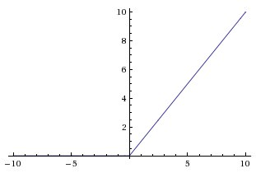

What is a Neural Network Activation Function?
An Activation Function decides whether a neuron should be activated or not. This means that it will decide whether the neuron's input to the network is important or not in the process of prediction using simpler mathematical operations.
Relu :
ReLU. The ReLU function is another non-linear activation function that has gained popularity in the deep learning domain. ReLU stands for Rectified Linear Unit. The main advantage of using the ReLU function over other activation functions is that it does not activate all the neurons at the same time.
Sigmoid:
The Sigmoid function performs the role of an activation function in machine learning which is used to add non-linearity in a machine learning model. Basically, the function determines which value to pass as output and what not to pass as output.

Slide 8
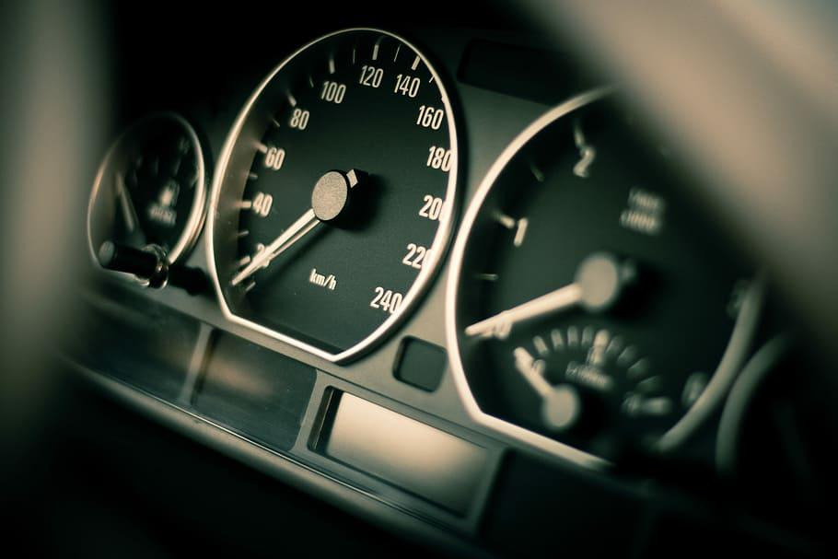
Auto Mpg
By Paul Abhishek

Slide 9
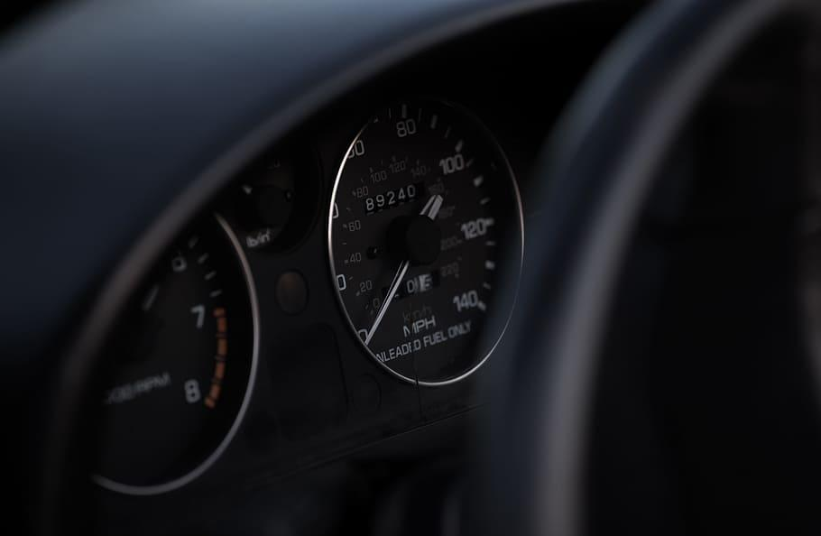
Background
Objective
Path
MPG stands for miles per gallon and is used to show how far your car can travel for every gallon (or 4.55 litres) of fuel it uses. For example, if you own a car that returns 50mpg and its fuel tank only has one gallon of petrol or diesel in it, you’ll drive 50 miles before the car runs out of fuel.
To determine the Miles Per Gallon (MPG) by the given inputs.
The data set has a continuous outcome which varies from x to x . Preprocessing of the Data and Exploratory Data Analysis are done using python, pandas functions. Neural Network regression algorithm is applied on various train test ratios and run through Different architectures to obtain the best model which gives the lowest MAE.

Slide 10
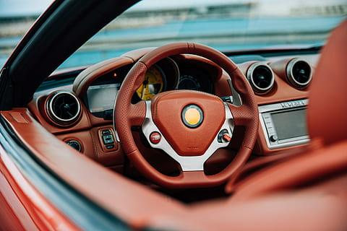
Data and Data quality check
The dataset consists of 142 rows and 20 columns
6 null values were found
The attributes to be noticed are mpg,cylinders,displacement, horsepower, weight, acceleration.
Object column (HorsePower) is converted into integer type.
All the attributes are numeric Type.
No outliers were found.
Outcome is continuous

Slide 11

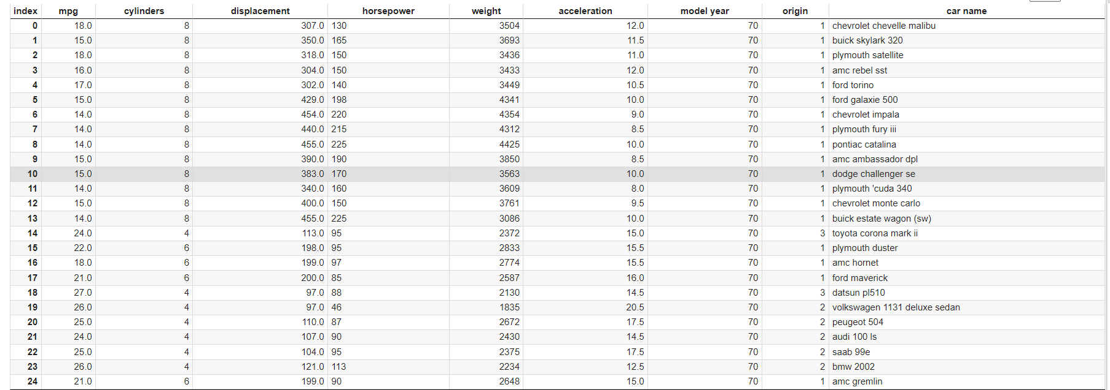
DataFrame

Slide 12
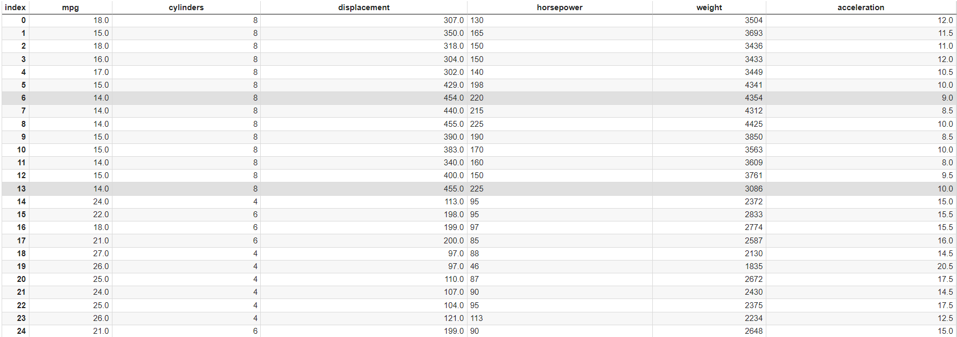
Modified DataFrame

Slide 13

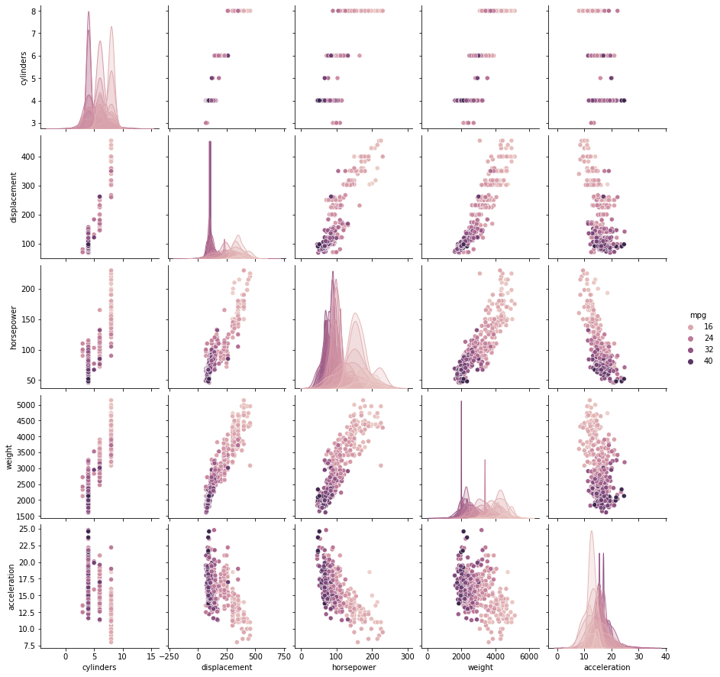
PairPlots
Pair Plots are a really simple (one-line-of-code simple!) way to visualize relationships between each variable. It produces a matrix of relationships between each variable in your data for an instant examination of our data. It can also be a great jumping off point for determining types of regression analysis to use.

Slide 14
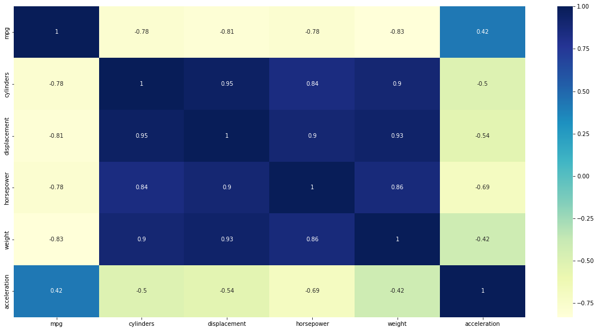
Heatmap
By definition, Heat Maps are graphical representations of data that utilize color-coded systems. The primary purpose of Heat Maps is to better visualize the volume of locations/events within a dataset and assist in directing viewers towards areas on data visualizations that matter most.In this dataset most of the attributes are highly correlated with each other.

Slide 15

Combinations used while experimenting
Test Size - Train size:
20 - 80
25 - 75
30 - 70
40 - 80
Epochs:
100
200
300
400
Architectures:
10-5-3-1
10-6-3-2-1
6-3-2-1
6-3-1
Optimizers:
Adam
SGD

Slide 16

train test Proportion | Architecture | Optimizer | Epochs | MAE
20-80 | 10-5-3-1 | Adam | 100 | 5.6974
20-80 | 10-5-3-1 | Adam | 200 | 4.3886
20-80 | 10-5-3-1 | Adam | 300 | 5.1916
20-80 | 10-5-3-1 | Adam | 400 | 4.1584
20-80 | 10-5-3-1 | SGD | 100 | nan
20-80 | 10-5-3-1 | SGD | 200 | nan
20-80 | 10-5-3-1 | SGD | 300 | nan
20-80 | 10-5-3-1 | SGD | 400 | nan
20-80 | 10-6-3-2-1 | Adam | 100 | 6.1529
20-80 | 10-6-3-2-1 | Adam | 200 | 4.6579
20-80 | 10-6-3-2-1 | Adam | 300 | 4.1389
20-80 | 10-6-3-2-1 | Adam | 400 | 4.7107
20-80 | 10-6-3-2-1 | SGD | 100 | nan
20-80 | 10-6-3-2-1 | SGD | 200 | nan
20-80 | 10-6-3-2-1 | SGD | 300 | nan
20-80 | 10-6-3-2-1 | SGD | 400 | nan
20-80 | 6-3-2-1 | Adam | 100 | 5.1082
20-80 | 6-3-2-1 | Adam | 200 | 4.4675

Slide 17
20-80 | 6-3-2-1 | Adam | 300 | 6.457
20-80 | 6-3-2-1 | Adam | 400 | 4.5726
20-80 | 6-3-2-1 | SGD | 100 | nan
20-80 | 6-3-2-1 | SGD | 200 | nan
20-80 | 6-3-2-1 | SGD | 300 | nan
20-80 | 6-3-2-1 | SGD | 400 | nan
20-80 | 6-3--1 | Adam | 100 | 11.5905
20-80 | 6-3--1 | Adam | 200 | 4.4426
20-80 | 6-3--1 | Adam | 300 | 6.6574
20-80 | 6-3--1 | Adam | 400 | 4.2219
20-80 | 6-3--1 | SGD | 100 | nan
20-80 | 6-3--1 | SGD | 200 | nan
20-80 | 6-3--1 | SGD | 300 | nan
20-80 | 6-3--1 | SGD | 400 | nan
25-75 | 10-5-3-1 | Adam | 100 | 5.8217
25-75 | 10-5-3-1 | Adam | 200 | 5.4238
25-75 | 10-5-3-1 | Adam | 300 | 6.3053
25-75 | 10-5-3-1 | Adam | 400 | 5.6485
25-75 | 10-5-3-1 | SGD | 100 | nan

Slide 18
25-75 | 10-5-3-1 | SGD | 200 | nan
25-75 | 10-5-3-1 | SGD | 300 | nan
25-75 | 10-5-3-1 | SGD | 400 | nan
25-75 | 10-6-3-2-1 | Adam | 100 | 5.568
25-75 | 10-6-3-2-1 | Adam | 200 | 6.6522
25-75 | 10-6-3-2-1 | Adam | 300 | 4.424
25-75 | 10-6-3-2-1 | Adam | 400 | 6.0586
25-75 | 10-6-3-2-1 | SGD | 100 | nan
25-75 | 10-6-3-2-1 | SGD | 200 | nan
25-75 | 10-6-3-2-1 | SGD | 300 | nan
25-75 | 10-6-3-2-1 | SGD | 400 | nan
25-75 | 6-3-2-1 | Adam | 100 | 6.1636
25-75 | 6-3-2-1 | Adam | 200 | 5.226
25-75 | 6-3-2-1 | Adam | 300 | 4.0248
25-75 | 6-3-2-1 | Adam | 400 | 6.4666
25-75 | 6-3-2-1 | SGD | 100 | nan
25-75 | 6-3-2-1 | SGD | 200 | nan
25-75 | 6-3-2-1 | SGD | 300 | nan
25-75 | 6-3-2-1 | SGD | 400 | nan

Slide 19
25-75 | 6-3--1 | Adam | 100 | 5.9229
25-75 | 6-3--1 | Adam | 200 | 4.8127
25-75 | 6-3--1 | Adam | 300 | 4.77
25-75 | 6-3--1 | Adam | 400 | 10.548
25-75 | 6-3--1 | SGD | 100 | nan
25-75 | 6-3--1 | SGD | 200 | nan
25-75 | 6-3--1 | SGD | 300 | nan
25-75 | 6-3--1 | SGD | 400 | nan
30-70 | 10-5-3-1 | Adam | 100 | 5.8217
30-70 | 10-5-3-1 | Adam | 200 | 4.7885
30-70 | 10-5-3-1 | Adam | 300 | 4.5742
30-70 | 10-5-3-1 | Adam | 400 | 5.065
30-70 | 10-5-3-1 | SGD | 100 | nan
30-70 | 10-5-3-1 | SGD | 200 | nan
30-70 | 10-5-3-1 | SGD | 300 | nan
30-70 | 10-5-3-1 | SGD | 400 | nan
30-70 | 10-6-3-2-1 | Adam | 100 | 5.2788
30-70 | 10-6-3-2-1 | Adam | 200 | 4.3113
30-70 | 10-6-3-2-1 | Adam | 300 | 5.2044

Slide 20
30-70 | 10-6-3-2-1 | Adam | 400 | 6.0586
30-70 | 10-6-3-2-1 | SGD | 100 | nan
30-70 | 10-6-3-2-1 | SGD | 200 | nan
30-70 | 10-6-3-2-1 | SGD | 300 | nan
30-70 | 10-6-3-2-1 | SGD | 400 | nan
30-70 | 6-3-2-1 | Adam | 100 | 5.9337
30-70 | 6-3-2-1 | Adam | 200 | 4.6061
30-70 | 6-3-2-1 | Adam | 300 | 4.8186
30-70 | 6-3-2-1 | Adam | 400 | 4.2779
30-70 | 6-3-2-1 | SGD | 100 | nan
30-70 | 6-3-2-1 | SGD | 200 | nan
30-70 | 6-3-2-1 | SGD | 300 | nan
30-70 | 6-3-2-1 | SGD | 400 | nan
30-70 | 6-3--1 | Adam | 100 | 7.4012
30-70 | 6-3--1 | Adam | 200 | 12.2685
30-70 | 6-3--1 | Adam | 300 | 6.2578
30-70 | 6-3--1 | Adam | 400 | 5.4085
30-70 | 6-3--1 | SGD | 100 | nan
30-70 | 6-3--1 | SGD | 200 | nan

Slide 21
30-70 | 6-3--1 | SGD | 300 | nan
30-70 | 6-3--1 | SGD | 400 | nan
35-75 | 10-5-3-1 | Adam | 100 | 6.8723
35-75 | 10-5-3-1 | Adam | 200 | 4.5116
35-75 | 10-5-3-1 | Adam | 300 | 4.7849
35-75 | 10-5-3-1 | Adam | 400 | 4.3661
35-75 | 10-5-3-1 | SGD | 100 | nan
35-75 | 10-5-3-1 | SGD | 200 | nan
35-75 | 10-5-3-1 | SGD | 300 | nan
35-75 | 10-5-3-1 | SGD | 400 | nan
35-75 | 10-6-3-2-1 | Adam | 100 | 7.5295
35-75 | 10-6-3-2-1 | Adam | 200 | 6.1945
35-75 | 10-6-3-2-1 | Adam | 300 | 4.6792
35-75 | 10-6-3-2-1 | Adam | 400 | 4.3261
35-75 | 10-6-3-2-1 | SGD | 100 | nan
35-75 | 10-6-3-2-1 | SGD | 200 | nan
35-75 | 10-6-3-2-1 | SGD | 300 | nan
35-75 | 10-6-3-2-1 | SGD | 400 | nan
35-75 | 6-3-2-1 | Adam | 100 | 6.0759

Slide 22
35-75 | 6-3-2-1 | Adam | 200 | 4.727
35-75 | 6-3-2-1 | Adam | 300 | 6.109
35-75 | 6-3-2-1 | Adam | 400 | 4.397
35-75 | 6-3-2-1 | SGD | 100 | nan
35-75 | 6-3-2-1 | SGD | 200 | nan
35-75 | 6-3-2-1 | SGD | 300 | nan
35-75 | 6-3-2-1 | SGD | 400 | nan
35-75 | 6-3--1 | Adam | 100 | 6.0983
35-75 | 6-3--1 | Adam | 200 | 7.2459
35-75 | 6-3--1 | Adam | 300 | 4.9364
35-75 | 6-3--1 | Adam | 400 | 18.2616
35-75 | 6-3--1 | SGD | 100 | nan
35-75 | 6-3--1 | SGD | 200 | nan
35-75 | 6-3--1 | SGD | 300 | nan
35-75 | 6-3--1 | SGD | 400 | nan
40-60 | 10-5-3-1 | Adam | 100 | 8.3044
40-60 | 10-5-3-1 | Adam | 200 | 5.0884
40-60 | 10-5-3-1 | Adam | 300 | 5.0592
40-60 | 10-5-3-1 | Adam | 400 | 6.8075

Slide 23
40-60 | 6-3-2-1 | SGD | 400 | nan
40-60 | 6-3--1 | Adam | 100 | 5.4525
40-60 | 6-3--1 | Adam | 200 | 37.3416
40-60 | 6-3--1 | Adam | 300 | 5.9473
40-60 | 6-3--1 | Adam | 400 | 8.0715
40-60 | 6-3--1 | SGD | 100 | nan
40-60 | 6-3--1 | SGD | 200 | nan
40-60 | 6-3--1 | SGD | 300 | nan
40-60 | 6-3--1 | SGD | 400 | nan

Slide 24
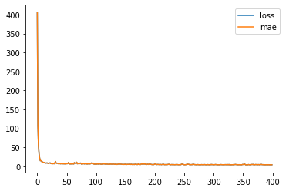
Best combination for lowest MAE
Test size : 30%
Architecture : 6-3-2-1
Optimizer : Adam
Epochs : 400
MAE : 4.2279
30-70 | 6-3-2-1 | Adam | 400 | 4.2779

Slide 25
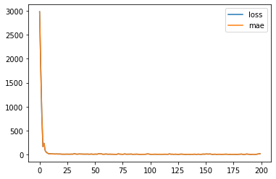
Worst case scenario
Test size : 40%
Architecture : 6-3-1
Optimizer : Adam
Epochs : 200
MAE : 37.3416
40-60 | 6-3--1 | Adam | 200 | 37.3416

Slide 26
Conclusion
The results form the table clearly states that the best optimizer out there is Adam. The reason it is best because at most of the times it gives higher accuracy when compared to SGD.
Nan values were showing up when the optimizer was SGD.
So, it is suggested to use Adam optimizer over SGD.
Best Results :
Worst Results :
Test size : 30%
Architecture : 6-3-2-1
Optimizer : Adam
Epochs : 400 : 400
MAE : 4.2279
Test size : 40%
Architecture : 6-3-1
Optimizer : Adam
Epochs : 400 : 400
MAE : 37.346

Slide 27

By Paul Abhishek

Slide 28
Background
Hepatitis means inflammation of the liver. The liver is a vital organ that processes nutrients, filters the blood, and fights infections. When the liver is inflamed or damaged, its function can be affected. Heavy alcohol use, toxins, some medications, and certain medical conditions can cause hepatitis.
Objective
The main objective of the dataset is to predict the chance of survival of a person whose suffering from hepatitis.
Path
The dataset is is a binary outcome dataset. It is a yes/no dataset. Preprocessing of the Data and Exploratory Data Analysis is applied. Neural Network in the category of the classification is used to determine the accuracy of the data set.

Slide 29
Data and Data quality check
The dataset consists of 142 rows and 20 columns
Every attribute is important in determining the output.
The outcome is binary. (live/dead)
No missing values were found in the dataset.
Output attribute : ‘Class’
Binary Outcome

Slide 30
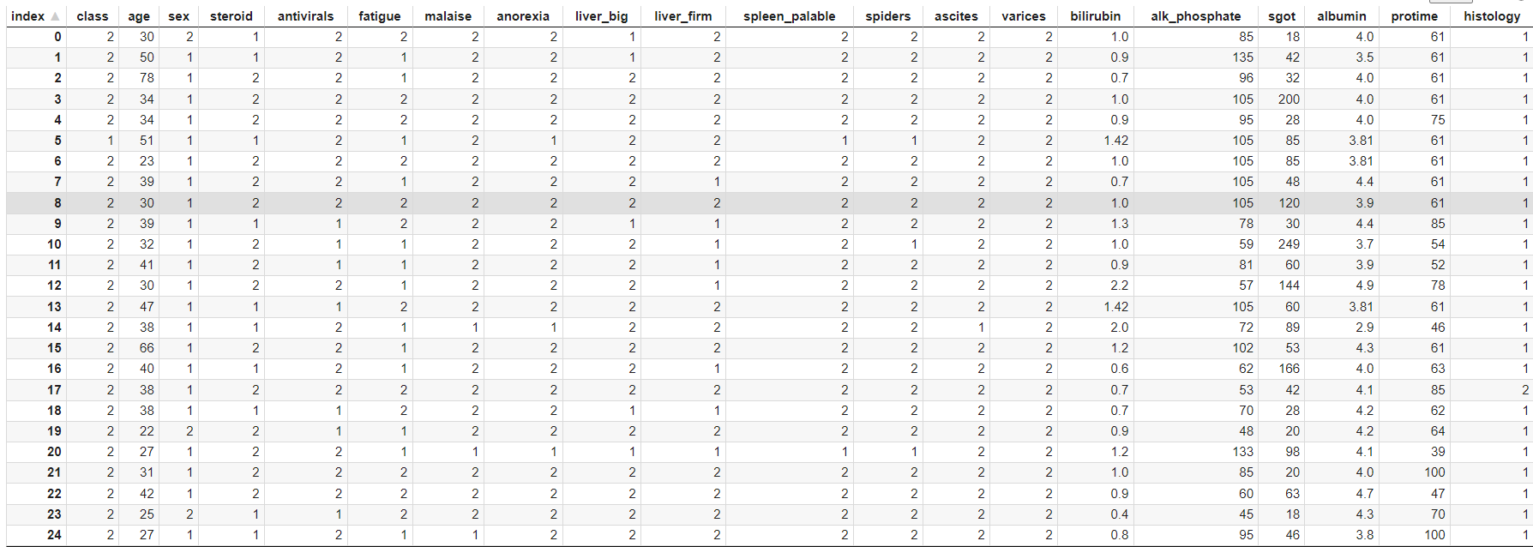
DataFrame

Slide 31
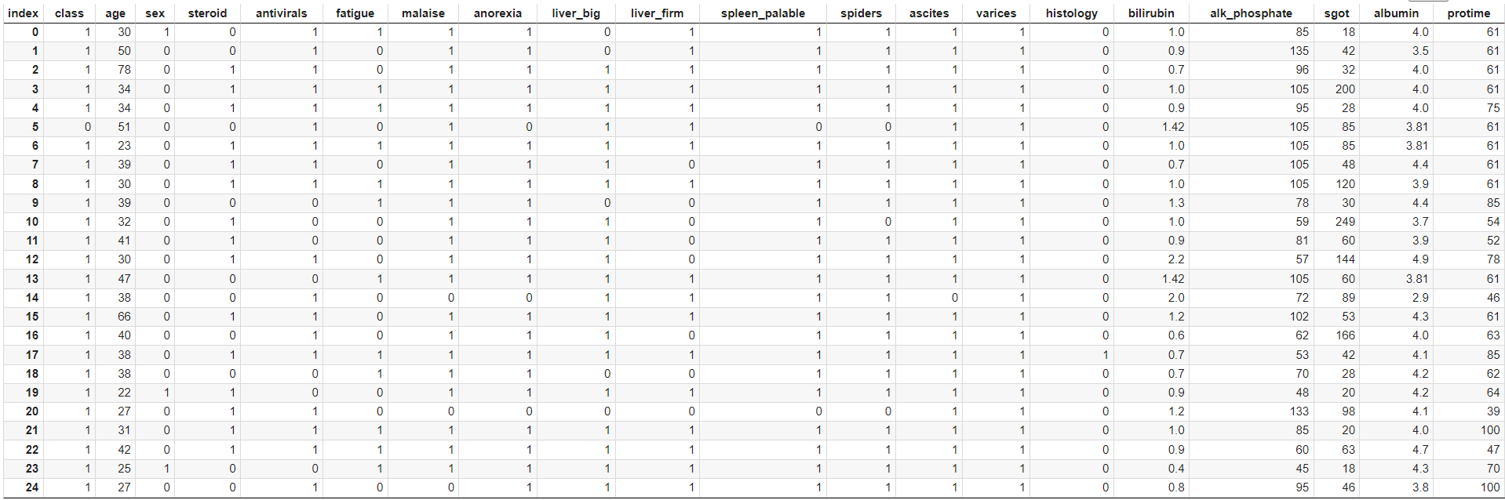
Modified DataFrame

Slide 32
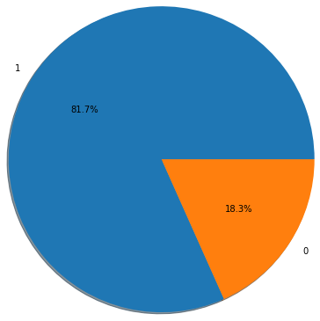
People died vs survived

Slide 33
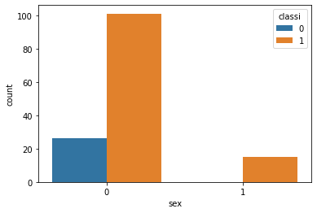
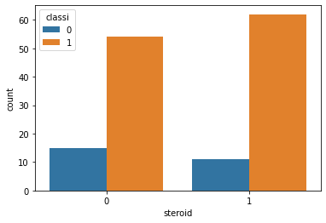
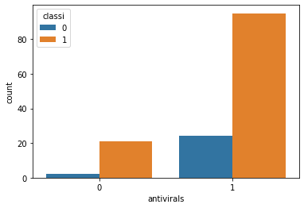
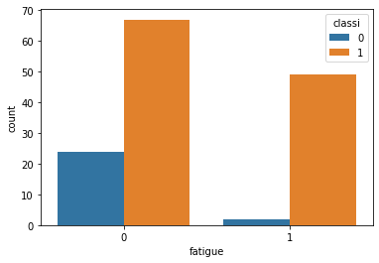
Count
plots

Slide 34
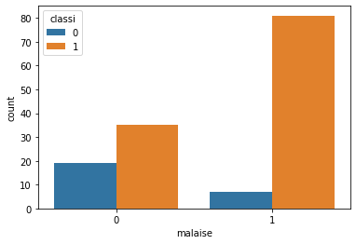
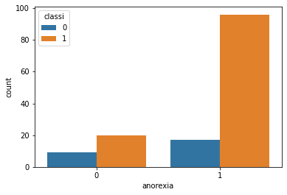
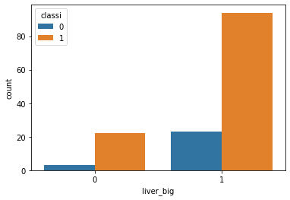
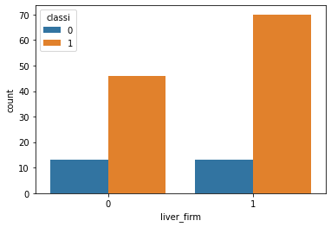
Count
plots

Slide 35
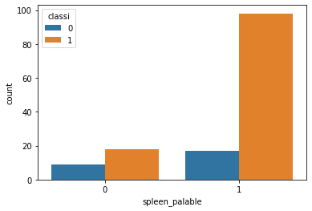
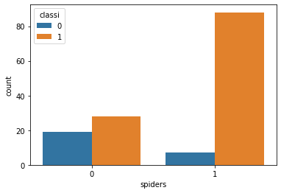
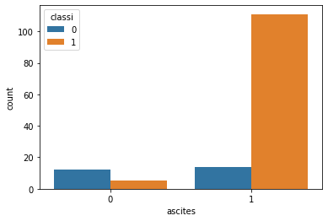
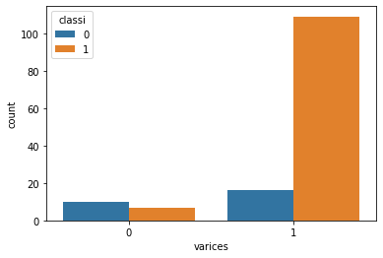
Count
plots

Slide 36
Take away from Graphs
People with antivirals have a very high chance of surviving.
People with less fatigue have a high chance of surviving.
People with anorexia have a high chance of surviving
In the graph steroids don’t play a major role in detecting the chances of survival

Slide 37
Combinations used while experimenting
Test Size - Train size:
20 - 80
25 - 75
30 - 70
40 - 80
Epochs:
100
200
300
400
Architectures:
10-5-3-1
10-6-3-2-1
6-3-2-1
6-3-1
Optimizers:
Adam
SGD

Slide 38
Experimentation
train test Proportion | Architecture | Optimizer | Epochs | Accuracy
20-80 | 10-5-3-1 | Adam | 100 | 0.8966
20-80 | 10-5-3-1 | Adam | 200 | 0.8966
20-80 | 10-5-3-1 | Adam | 300 | 0.8966
20-80 | 10-5-3-1 | Adam | 400 | 0.8966
20-80 | 10-5-3-1 | SGD | 100 | 0.8966
20-80 | 10-5-3-1 | SGD | 200 | 0.8966
20-80 | 10-5-3-1 | SGD | 300 | 0.8966
20-80 | 10-5-3-1 | SGD | 400 | 0.8966
20-80 | 10-6-3-2-1 | Adam | 100 | 0.8966
20-80 | 10-6-3-2-1 | Adam | 200 | 0.8966
20-80 | 10-6-3-2-1 | Adam | 300 | 0.8966
20-80 | 10-6-3-2-1 | Adam | 400 | 0.8966
20-80 | 10-6-3-2-1 | SGD | 100 | 0.8966

Slide 39
20-80 | 10-6-3-2-1 | SGD | 200 | 0.8966
20-80 | 10-6-3-2-1 | SGD | 300 | 0.8966
20-80 | 10-6-3-2-1 | SGD | 400 | 0.8966
20-80 | 6-3-2-1 | Adam | 100 | 0.8966
20-80 | 6-3-2-1 | Adam | 200 | 0.8621
20-80 | 6-3-2-1 | Adam | 300 | 0.8621
20-80 | 6-3-2-1 | Adam | 400 | 0.8621
20-80 | 6-3-2-1 | SGD | 100 | 0.8966
20-80 | 6-3-2-1 | SGD | 200 | 0.8966
20-80 | 6-3-2-1 | SGD | 300 | 0.8966
20-80 | 6-3-2-1 | SGD | 400 | 0.8966
20-80 | 6-3--1 | Adam | 100 | 0.8966
20-80 | 6-3--1 | Adam | 200 | 0.8966
20-80 | 6-3--1 | Adam | 300 | 0.8966

Slide 40
20-80 | 6-3--1 | Adam | 400 | 0.8966
20-80 | 6-3--1 | SGD | 100 | 0.8966
20-80 | 6-3--1 | SGD | 200 | 0.8966
20-80 | 6-3--1 | SGD | 300 | 0.8966
20-80 | 6-3--1 | SGD | 400 | 0.8966
25-75 | 10-5-3-1 | Adam | 100 | 0.8889
25-75 | 10-5-3-1 | Adam | 200 | 0.8889
25-75 | 10-5-3-1 | Adam | 300 | 0.8889
25-75 | 10-5-3-1 | Adam | 400 | 0.8889
25-75 | 10-5-3-1 | SGD | 100 | 0.8889
25-75 | 10-5-3-1 | SGD | 200 | 0.8889
25-75 | 10-5-3-1 | SGD | 300 | 0.8889
25-75 | 10-5-3-1 | SGD | 400 | 0.8889
25-75 | 10-6-3-2-1 | Adam | 100 | 0.8889

Slide 41
25-75 | 10-6-3-2-1 | Adam | 200 | 0.8889
25-75 | 10-6-3-2-1 | Adam | 300 | 0.8889
25-75 | 10-6-3-2-1 | Adam | 400 | 0.8889
25-75 | 10-6-3-2-1 | SGD | 100 | 0.8889
25-75 | 10-6-3-2-1 | SGD | 200 | 0.8889
25-75 | 10-6-3-2-1 | SGD | 300 | 0.8889
25-75 | 10-6-3-2-1 | SGD | 400 | 0.8889
25-75 | 6-3-2-1 | Adam | 100 | 0.8056
25-75 | 6-3-2-1 | Adam | 200 | 0.8611
25-75 | 6-3-2-1 | Adam | 300 | 0.8333
25-75 | 6-3-2-1 | Adam | 400 | 0.8611
25-75 | 6-3-2-1 | SGD | 100 | 0.8889
25-75 | 6-3-2-1 | SGD | 200 | 0.8889
25-75 | 6-3-2-1 | SGD | 300 | 0.8889

Slide 42
25-75 | 6-3-2-1 | SGD | 400 | 0.8889
25-75 | 6-3--1 | Adam | 100 | 0.8889
25-75 | 6-3--1 | Adam | 200 | 0.8889
25-75 | 6-3--1 | Adam | 300 | 0.8889
25-75 | 6-3--1 | Adam | 400 | 0.8889
25-75 | 6-3--1 | SGD | 100 | 0.8889
25-75 | 6-3--1 | SGD | 200 | 0.8889
25-75 | 6-3--1 | SGD | 300 | 0.8889
25-75 | 6-3--1 | SGD | 400 | 0.8889
30-70 | 10-5-3-1 | Adam | 100 | 0.8837
30-70 | 10-5-3-1 | Adam | 200 | 0.8837
30-70 | 10-5-3-1 | Adam | 300 | 0.8837
30-70 | 10-5-3-1 | Adam | 400 | 0.8837
30-70 | 10-5-3-1 | SGD | 100 | 0.8837

Slide 43
30-70 | 10-5-3-1 | SGD | 200 | 0.8837
30-70 | 10-5-3-1 | SGD | 300 | 0.8837
30-70 | 10-5-3-1 | SGD | 400 | 0.8837
30-70 | 10-6-3-2-1 | Adam | 100 | 0.8837
30-70 | 10-6-3-2-1 | Adam | 200 | 0.8837
30-70 | 10-6-3-2-1 | Adam | 300 | 0.8837
30-70 | 10-6-3-2-1 | Adam | 400 | 0.8837
30-70 | 10-6-3-2-1 | SGD | 100 | 0.8837
30-70 | 10-6-3-2-1 | SGD | 200 | 0.8837
30-70 | 10-6-3-2-1 | SGD | 300 | 0.8837
30-70 | 10-6-3-2-1 | SGD | 400 | 0.8837
30-70 | 6-3-2-1 | Adam | 100 | 0.814
30-70 | 6-3-2-1 | Adam | 200 | 0.8837
30-70 | 6-3-2-1 | Adam | 300 | 0.8372

Slide 44
30-70 | 6-3-2-1 | Adam | 400 | 0.8837
30-70 | 6-3-2-1 | SGD | 100 | 0.8837
30-70 | 6-3-2-1 | SGD | 200 | 0.8837
30-70 | 6-3-2-1 | SGD | 300 | 0.8837
30-70 | 6-3-2-1 | SGD | 400 | 0.8837
30-70 | 6-3--1 | Adam | 100 | 0.8372
30-70 | 6-3--1 | Adam | 200 | 0.8837
30-70 | 6-3--1 | Adam | 300 | 0.8837
30-70 | 6-3--1 | Adam | 400 | 0.8837
30-70 | 6-3--1 | SGD | 100 | 0.8837
30-70 | 6-3--1 | SGD | 200 | 0.8837
30-70 | 6-3--1 | SGD | 300 | 0.8837
30-70 | 6-3--1 | SGD | 400 | 0.8837
35-75 | 10-5-3-1 | Adam | 100 | 0.86

Slide 45
35-75 | 10-5-3-1 | Adam | 200 | 0.9
35-75 | 10-5-3-1 | Adam | 300 | 0.78
35-75 | 10-5-3-1 | Adam | 400 | 0.8
35-75 | 10-5-3-1 | SGD | 100 | 0.86
35-75 | 10-5-3-1 | SGD | 200 | 0.8
35-75 | 10-5-3-1 | SGD | 300 | 0.86
35-75 | 10-5-3-1 | SGD | 400 | 0.86
35-75 | 10-6-3-2-1 | Adam | 100 | 0.86
35-75 | 10-6-3-2-1 | Adam | 200 | 0.86
35-75 | 10-6-3-2-1 | Adam | 300 | 0.86
35-75 | 10-6-3-2-1 | Adam | 400 | 0.86
35-75 | 10-6-3-2-1 | SGD | 100 | 0.86
35-75 | 10-6-3-2-1 | SGD | 200 | 0.86
35-75 | 10-6-3-2-1 | SGD | 300 | 0.86

Slide 46
35-75 | 10-6-3-2-1 | SGD | 400 | 0.86
35-75 | 6-3-2-1 | Adam | 100 | 0.82
35-75 | 6-3-2-1 | Adam | 200 | 0.82
35-75 | 6-3-2-1 | Adam | 300 | 0.82
35-75 | 6-3-2-1 | Adam | 400 | 0.54
35-75 | 6-3-2-1 | SGD | 100 | 0.86
35-75 | 6-3-2-1 | SGD | 200 | 0.86
35-75 | 6-3-2-1 | SGD | 300 | 0.86
35-75 | 6-3-2-1 | SGD | 400 | 0.86
35-75 | 6-3--1 | Adam | 100 | 0.84
35-75 | 6-3--1 | Adam | 200 | 0.86
35-75 | 6-3--1 | Adam | 300 | 0.86
35-75 | 6-3--1 | Adam | 400 | 0.88
35-75 | 6-3--1 | SGD | 100 | 0.86

Slide 47
35-75 | 6-3--1 | SGD | 200 | 0.86
35-75 | 6-3--1 | SGD | 300 | 0.86
35-75 | 6-3--1 | SGD | 400 | 0.86
40-60 | 10-5-3-1 | Adam | 100 | 0.8596
40-60 | 10-5-3-1 | Adam | 200 | 0.8596
40-60 | 10-5-3-1 | Adam | 300 | 0.8596
40-60 | 10-5-3-1 | Adam | 400 | 0.8596
40-60 | 10-5-3-1 | SGD | 100 | 0.8596
40-60 | 10-5-3-1 | SGD | 200 | 0.8596
40-60 | 10-5-3-1 | SGD | 300 | 0.8596
40-60 | 10-5-3-1 | SGD | 400 | 0.8596
40-60 | 10-6-3-2-1 | Adam | 100 | 0.8596
40-60 | 10-6-3-2-1 | Adam | 200 | 0.8596
40-60 | 10-6-3-2-1 | Adam | 300 | 0.8596

Slide 48
40-60 | 10-6-3-2-1 | Adam | 400 | 0.8596
40-60 | 10-6-3-2-1 | SGD | 100 | 0.8596
40-60 | 10-6-3-2-1 | SGD | 200 | 0.8596
40-60 | 10-6-3-2-1 | SGD | 300 | 0.8596
40-60 | 10-6-3-2-1 | SGD | 400 | 0.8596
40-60 | 6-3-2-1 | Adam | 100 | 0.8421
40-60 | 6-3-2-1 | Adam | 200 | 0.7895
40-60 | 6-3-2-1 | Adam | 300 | 0.807
40-60 | 6-3-2-1 | Adam | 400 | 0.7895
40-60 | 6-3-2-1 | SGD | 100 | 0.8596
40-60 | 6-3-2-1 | SGD | 200 | 0.8596
40-60 | 6-3-2-1 | SGD | 300 | 0.8596
40-60 | 6-3-2-1 | SGD | 400 | 0.8596
40-60 | 6-3--1 | Adam | 100 | 0.8421

Slide 49
40-60 | 6-3--1 | Adam | 200 | 0.8596
40-60 | 6-3--1 | Adam | 300 | 0.8596
40-60 | 6-3--1 | Adam | 400 | 0.8596
40-60 | 6-3--1 | SGD | 100 | 0.8596
40-60 | 6-3--1 | SGD | 200 | 0.8596
40-60 | 6-3--1 | SGD | 300 | 0.8596
40-60 | 6-3--1 | SGD | 400 | 0.8596

Slide 50
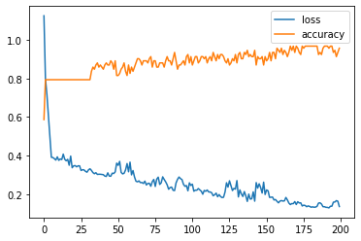
Best combination for highest accuracy
Test size : 35 %
Architecture : 10-5-3-1
Optimizer : Adam
Epochs : 200
Accuracy : 90 %
35-75 | 10-5-3-1 | Adam | 200 | 0.9

Slide 51
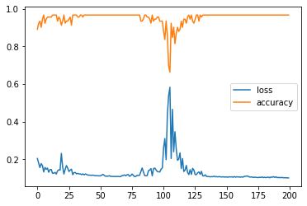
Same combination but the Optimizer is SGD
Test size : 35%
Architecture : 10-5-3-1
Optimizer : Adam
Epochs : 200
Accuracy : 80 %
35-75 | 10-5-3-1 | SGD | 200 | 0.8

Slide 52
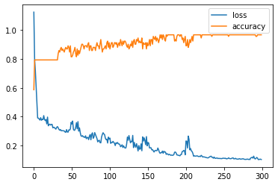
Worst Case Scenario
Test size : 35%
Architecture : 10-5-3-1
Optimizer : Adam
Epochs : 300
Accuracy : 70%
35-75 | 10-5-3-1 | Adam | 300 | 0.78

Slide 53
Conclusion
The results form the table clearly states that the best optimizer out there is Adam. The reason it is best because at most of the times it gives higher accuracy when compared to SGD.
So, it is suggested to use Adam optimizer over SGD
The best possible combination :
Test size : 35 %
Architecture : 10-5-3-1
optimizer : Adam
Epochs : 200
Accuracy : 90 %

